Slide 1
EVERY CHILD MATTERS (revisited)
Addressing Diversity and ‘Difference’
^{2 February 2009}
Dr Sarah Whitelaw

Slide 2

Purposes of the session
To remind of/revisit the ECM ‘agenda’
To raise some issues relating to diversity and difference – gender, ethnicity and social class - arising from the ECM agenda
To get you to analyse your own ideas and assumptions – and the bases for them
To introduce some ideas and theoretical positions, arising from research, concerning diversity and difference
To suggest some responses and strategies
To set tasks and questions

Slide 3
The ECM agenda ….. Reminders – vis attainment and achievement
Effective communication and engagement with children, young people, their families and carers;
Child and young person development;
Safeguarding and promoting the welfare of the child;
Supporting transitions;
Multi-agency working;
Sharing information
- The ‘Outcomes Framework

Slide 4
The ‘Outcomes Framework
Being healthy
Enjoying and achieving
Staying safe
Making a positive contribution
Achieving economic well-being

Slide 5
The Big Picture – education policy
School improvement
Raising Standards
Inclusion
…… an ‘achievement’ (not just academic attainment ) focussed agenda …..

Slide 6
Take 3 minutes to discuss these questions with your neighbour
To what extent do you expect to see ‘ability’ evenly distributed amongst different social and cultural groups ??
To what extent do you expect to see differences in academic attainment amongst different social and cultural groups ??

Slide 7
Social grouping and achievement ……. Gender, Ethnicity and Class
What the statistics say
What research, school and teacher experiences tells us

Slide 8
Longitudinal Study of Young People in England (LSYPE)
Dr. Steve Strand
Associate Professor
University of Warwick

Slide 9
Longitudinal Study of Young People in England (LSYPE)
Large scale, DCSF funded
  15,770 Y9 pupils (aged 14) in 2004
  Over sampled the six major ethnic minorities (Indian, Pakistani, Bangladeshi, Black Caribbean, Black African & Mixed heritage)
  647 secondary schools, includes independent sector & PRUs
Detailed in-depth data
  Extended face to face interview with Young Person, 45 min main parent interview, 10 min second parent interview, links to ASC & NPD (KS2, KS3, GCSE/GNVQ) .
Longitudinal tracking
  Subsequent interviews at Wave 2 in 2005 & Wave 3 in 2006, further follow up planned through until age 25 (2015).
Aims
  to better understand the factors influencing attainment and progress during secondary school.

Slide 10
What are the
attainment facts ???

Slide 11
Gender gap
Gender | Total Points Score | 5+ A*-C incl. Eng & maths
Girls | 0.07 | 49%
Boys | -0.15 | 41%
Gap | 0.22 | -7%
-0.22 SD = 36 points (e.g. converting 6 grade ‘D’ to 6 grade ‘C’) BUT gap is subject specific (e.g. -0.31 for English but only -0.07 for maths and science)

Slide 12
Ethnic gaps
Ethnic group | Total Points Score | 5+ A*-C incl. Eng & maths
Black Caribbean | -0.29 | 31%
Pakistani | -0.13 | 36%
Black African | -0.09 | 42%
Mixed heritage | -0.09 | 41%
White British | -0.05 | 45%
Bangladeshi | -0.04 | 42%
Any other group | 0.18 | 50%
Indian | 0.32 | 59%
Gap (lowest vs highest) | 0.61 | 28%

Slide 13
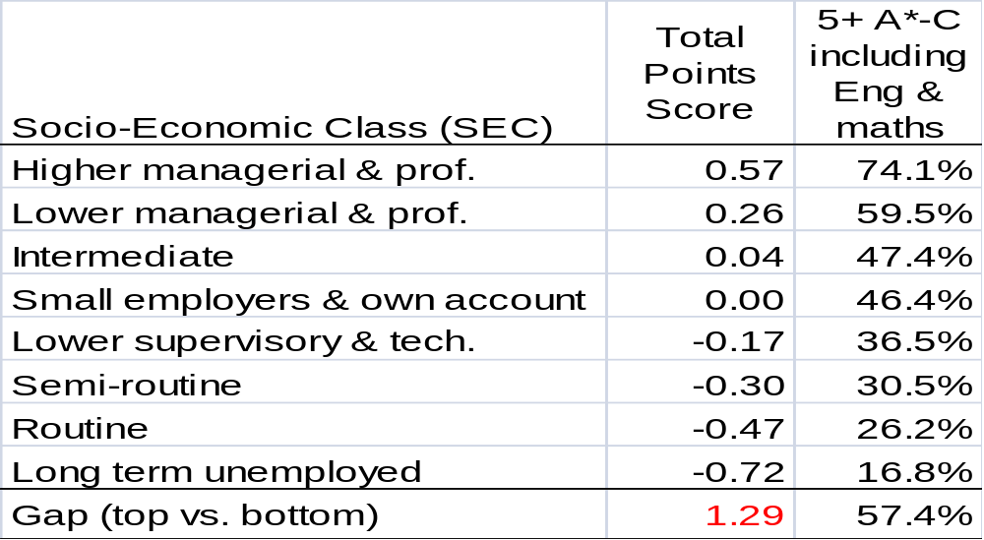
Socio-Economic Classification (SEC) gap

Slide 14
Summary – attainment gaps at age 16
Gap | Total points score (standardised) | 5+ A*-C incl. English & maths
Gender | 0.22 | 7%
Ethnic group | 0.61 | 28%
Socio-economic class | 1.29 | 57%
In inverse rank to the extent of press and media attention

Slide 15
Ethnicity, class and gender - Summary
In low SEC homes all minority ethnic groups make strong progress during KS4, and have caught up (Black Caribbean) or exceeded (all other groups) the attainment of White British pupils by age 16. Key resilience factors are high educational aspirations (both pupils & parents), strong academic self concept and strong commitment (homework).
In high SEC homes ethnic differentials remain strong, with Indian, Pakistani & Bangladeshi pupils outperforming White British (when social disadvantage is included in models). Again aspirations, ASC and homework can account for this. However Black Caribbean and Black African boys underachieve relative to their high aspirations, high ASC and comparable homework to White British peers.

Slide 16
What other relevant statistics say . some examples …..
In 2003/04 around 25 in every 10,000 pupils of mixed ethnic origin were permanently excluded from school. This was similar to the exclusion rate for Black pupils (29 in every 10,000) which
was around twice that for White pupils.
There are twice as many boys with learning difficulties as there are girls. In special units, boys outnumber girls by six to one. By seven years of age, one-third of boys, compared to one-fifth of girls, are struggling to read. Five times as many boys
The Sutton Trust says that in the top 200 schools, only 3% of pupils qualify for free school meals - compared to a national average of 14%.

Slide 17
What research, school and teacher experiences tells us …….
‘whilst there are clear differences in attainment between minority ethnic groups, influencing factors such as social class, date of arrival in Britain, and mother’s education account for a substantial number of these differences. In other words, some of the gaps in attainment that appear to be due to ethnic minority status, are in fact due to other, largely socio-economic factors’.
Haque, Zubaida & Bell, John F. Oxford Review of Education, 2001, Vol 27, no 3, pp.359-368.
Having poor literacy skills, coupled with low parental expectations and poor self-esteem, can have a profound effect on educational life chances, employability and social cohesion. Those from groups often considered to be at risk of social exclusion may suffer from a double disadvantage if they also have low literacy skills.
http://www.literacytrust.org.uk/socialinclusion/disadvantagedindex.html

Slide 18
Questions …..
How have schools responded to such evidence ??
How do we, personally, respond to this evidence ?
How does this knowledge affect the way we approach our teaching and the pupils in our classes?

Slide 19
Should we ‘worry’ about things we ‘can’t change’ ……..???
Should we focus on the things that schools and teachers are able to influence ……??

Slide 20
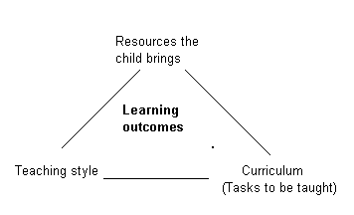
Influences on learning outcomes –
Source: Keogh, J.F., & Sugden, D.A. (1985). Movement skill development. New York: Macmillan.

Slide 21
What factors ‘make a difference’ to educational outcomes ??
– expansion of the three point model
Things we need to understand, know about and respond to …..
but on which we have limited influence …..
i.e. what the children themselves bring to the educational setting
(however we do have an influence on what they take away from it ……)

Slide 22
Children – and what they bring to the educational setting
The child’s capabilities and aptitudes - to be understood, assessed and developed;
The child’s attitudes and values – to be recognised/appreciated and worked with;
The child’s behaviour – to be understood, worked with and modified as necessary.
What factors may have influenced these ???

Slide 23
Social factors and innate difference – complex relationship
Upbringing and social training –
Powerful influences on capabilities as well as expectations, attitudes, values and behaviour.
Gender, sexuality, class, ‘dis/ability’, ethnicity and ‘race’
Inter-related social constructions which help to shape individual identities.
The child – personality, physiology, intellectual capability.

Slide 24
What factors ‘make a difference’ to educational outcomes ??
– expansion of the three point model
Things we need to understand, know about and respond to AND on which we DO HAVE – to a greater or lesser extent - influence …..
School cultures and ethos
Teaching and styles and classroom pedagogy
Assessment
Teacher attitudes and expectations

Slide 25
School cultures and ethos – some issues ……
‘Mis/match’ – the child’s ‘culture’ and the school’s:
The value/purpose of education
Life/career expectations
Behaviour ‘rules’
Attitudes towards others
Respect and authority …..
For example:
“School, for many boys, represents a system of hostile authority and a series of meaningless work demands”
Mike Younger Homerton College
http://www-rba.educ.cam.ac.uk/

Slide 26
School cultures and ethos – some issues …..
There is now substantial evidence that schools/teachers have considerable influence of pupil achievement and attainment through their:
Expectations and attitudes
Class and behaviour management systems
Approaches to Pastoral Care
Home/school relationships
Modelling (behaviour, attitudes, values etc.)

Slide 27
The schools’ and teachers’ ‘sphere of influence’ …
Unsurprisingly, teachers, particularly beginning teachers, start to ‘engage’ with these issues through a focus on the things over which they can exert direct influence in a very practical way i.e.
Interpretation of the curriculum
Subject matter selection
Pedagogy
Assessment

Slide 28
Classroom strategies – some things you can do !!!
Analyse resources for gender and ethnicity and class bias
Investigate preferred learning styles
Challenge Stereotypes
Negotiate targets with pupils individually
Deal explicitly with equality and diversity issues including peer pressure and sexual harassment
Include strategies for developing personal skills such as cooperation and negotiation
Use peer support for learning
‘Model’ appropriate behaviour and attitudes

Slide 29
Whole school strategies: but you can do some of this too …. http://www.standards.dfes.gov.uk/genderandachievement/
Develop a whole school seating policy
Regard an anti-swot culture as a major threat to equal opportunities
Challenge Stereotypes
Establish a school council
Provide academic mentoring in a range of ways and at various stages of school life
Consult pupils on a wide range of issues curricular, extra curricular and pastoral
Provide counselling, including peer counselling
Give pupils pastoral support roles
Explore teachers' understanding of issues related to gender, class and ethnicity and underachievement
Draw up a parents skill register
Map out individual pupil assessment statistics against previous data

Slide 30
Key Points
Take account of ‘difference’ – BUT beware of stereotyping
Be clear about relationships between generalised explanations of difference and individuals’ behaviours
Acknowledge your own role in ameliorating differentiated learning outcomes
Address these issues in your behaviour and lesson plans – teachers and schools CAN AND DO ‘make a difference’ !!

Slide 31
Reminders about why is all this important …………..

Slide 32
ECM – some statistics
4.1 million live in poverty
2 million children go without at least two things they need such as three meals a day, toys or adequate clothes
Two thirds of heads of households in social housing are unemployed
16% of children live in households where no one works
40,000 girls under 18 become pregnant each year
Infants born to fathers in unskilled or semi skilled occupations have infant mortality rates over 70% higher than those in professional and managerial positions
Around 10% of children between the age of 5 and 15 experience some sort of mental disorder

Slide 33
Follow-up ‘tasks’ – method and school
What are the main areas of knowledge which you need to develop re the implications of diversity and difference issues?
What strategies/attitudes/behaviours can YOU put in place in your planning and teaching in order to help children to achieve their potential and address differentiated (gender/ethnicity/class) levels of attainment and achievement?
How is the ECM – inclusion and diversity - agenda being ‘taken up’ in your placement school/subject area?
Consider using the EPS2 project as an opportunity to research and address some of these issues
Consider using some of your ‘Activities weeks’ time at the end of the year to visit/work in a school or department which works closely with one or more of these issues

Slide 34
End note
There is now a considerable body of evidence that schools and teachers, individually and collectively, can make a positive difference to children’s lives …….
Whether they do or not is the challenge for all professional educators ……

Slide 35
Useful Sources
Strand, S. (2007). Minority ethnic pupils in the Longitudinal Study of Young People in England. DfES Research Report RR-002. London: Department for Children, Families and Schools. http://www.dfes.gov.uk/research/data/uploadfiles/DCSF-RR002.pdf
Strand, S. (2008). Minority ethnic pupils in the Longitudinal Study of Young People in England: Extension report on performance in public examinations at age 16. DCSF Research Report RR-029. London: Department for Children, Schools and Families. http://www.dfes.gov.uk/research/data/uploadfiles/DCSF-RR029.pdf

Slide 36
Useful Sources
http://www.standards.dfes.gov.uk/
Links from here to a wide variety of resources and research reports
Some useful journals:
Gender and Education
Journal of Inclusive Education
British Journal of Sociology of Education
British Educational Research Journal
List of relevant texts on the SoE website

Slide 37
Danny’s story ……http://www.standards.dfes.gov.uk/genderandachievement/goodpractice/secondarycs/secondarycs2/
My name is Danny Whitworth, I am now 17 years old and I am employed as a trainee chartered accountant in Manchester. I am doing well. I have passed the first year of my accountancy exams. I attended Middleton Technology School as a secondary school student. My secondary school career was successful at the end but very difficult. My dad was in prison whilst I was in Years 8, 9 and 10 and my great grandmother who I was very close to died when I was in Year 9. These events seriously affected me. I was quite violent in Years 8 and 9 as I felt I had to stand up for myself as my dad wasn't there. I was not concerned about the consequences of my behaviour, I didn't care at all. I just took out my anger on others. I was under threat of permanent exclusion from school.
In Year 10, the problems came to a head. Mr Yates, a teacher who took an interest in me, arranged for counselling from the Catholic Rescue Society in an attempt to help me. I went every other week. He took me or school paid for a taxi. No-one else, including my family, knew about this. There were still some problems but eventually over time they got less and less.
I was encouraged by staff to get more involved in sport and more focused on my studies. The turning point was the A* I got in maths at the end of Year 10. I then began to behave like a member of staff, stopping bullying and helping the younger ones. The A Level I passed in Year 11 was a real challenge giving me a huge boost. I got lots of help and my maths teacher gave me her home phone number so that I had 24 hour tutoring. I left school with two A*s , four As, two B's and two Cs at GCSE as well as the Advanced Level in mathematics.
I think I would have been permanently excluded from other schools but not at Middleton. There, for some reason, things were different.

Slide 38
Some research evidence to consider …….
Boaler,J; Wiliam,D and Brown, M (2000) ‘Students' Experiences of Ability Grouping - disaffection, polarisation and the construction of failure’ British Educational Research Journal Vol. 26:5 / December 1, 2000 pp 631 – 648
Ability-grouping was associated with curriculum polarisation i.e. restriction of opportunity to learn for students in lower sets, and students in top sets being required to learn at a pace which was, for many students, incompatible with understanding.
Teachers employed a more restricted range of teaching approaches with 'homogeneous' groups than with mixed-ability groups which impacted upon the students' experiences in profound and largely negative ways.
Almost all of the students interviewed from 'setted groups' were unhappy with their placement.

Slide 39
‘Boys’ ‘Under-Achievement’ ? Warrington and Younger et al (2005)
Overall, evidence suggests that the gender gap has stabilised, against a background of a rising trajectory of achievement for both girls and boys.
The diversity of gender constructions indicates that generalisations about ‘boys’ and ‘girls’ conceal as much as they reveal.
Many boys continue to achieve extremely well at school;
There are a substantial number of girls whose needs are not recognized within schools and who under-achieve;
The core of the issue in many schools revolves around a minority of pupils, rather than a majority;
the ‘problem’ needs to be carefully contextualised, both in scale and in response.
Although issues of image and status are crucial in impacting upon boys’ notions of masculinity, as they search for acceptability and respectability amongst their peers, there are boys who devise coping strategies that enable them to achieve academically.

Slide 40
Film Extracts
Language and Gender (1992) BBC ‘Scene’ English Curriculum material
Raising Boys’ Achievement (1997) Kirklees LEA
Available to view in the School of Education library – video collection

